Slide 1
Back-End Engineering (BEE)
The Fitness Club
Naina (2210991949)
Arsh Jain (2210991361)
Group: G22
Submitted To :
Mr. Rahul Singh Rajput

Slide 2
Table of Contents
Introduction
Problem Statement
Solution
Key Features
Technology Stack
System Architecture
Project Snapshots
References/Links used

Slide 3
INTRODUCTION
In today’s fast-paced fitness world, finding the perfect fitness club that meets personal wellness goals or managing memberships can be challenging. This report explores a next-generation fitness platform, The Fitness Club, built with React.js, Tailwind CSS, MongoDB, and Node.js, streamlining user engagement, workout tracking, club management for members and administrators and smart suggestions for the users.
With React’s dynamic capabilities, users can explore personalized fitness plans, view trainer schedules, and book workout sessions seamlessly. Tailwind CSS ensures a sleek, responsive design, making the platform accessible on any device, from desktops to smartphones. Node.js enables real-time communication for live updates, trainer interactions, or virtual session scheduling. MongoDB efficiently stores user profiles, workout history, and membership details, ensuring a smooth and seamless fitness journey for every user.
This platform empowers users to achieve their fitness goals effortlessly while providing club administrators with robust tools for efficient management.

Slide 4
Problem Statement
In today’s fast-paced lifestyle, maintaining a consistent fitness routine and tracking progress is challenging for individuals. Many fitness enthusiasts struggle with:
Lack of Personalized Tracking Users often lack a system that effectively monitors their workouts, calorie intake, and progress, leading to poor accountability and inconsistent results.
Manual Record-Keeping Tracking workout routines, calories burned, and dietary intake manually can be time-consuming and error-prone, making it difficult to measure progress accurately.
Limited Data Insights Traditional methods do not provide meaningful insights or visualizations, preventing users from identifying areas for improvement and optimizing their fitness plans.
Inaccessible Historical Records Without a centralized system to maintain workout and calorie records, users cannot easily compare past and current performance to stay motivated and on track.

Slide 5
Solution
Solution for Workout & Calorie Tracking Application
Advanced User Tracking
Log workouts and calorie intake seamlessly with an intuitive React.js interface.
Secure JWT-based authorization ensures personalized and protected user data.
Comprehensive Insights
View detailed stats with progress charts and trends to analyze performance.
Real-time feedback helps users stay on track to achieve fitness goals.
User-Friendly Interface
Clean, responsive design for smooth navigation across all devices.
Easily add, filter, and view workout and calorie records.
4.Engagement & Progress
Personalized dashboards with summaries and insights and Smart suggestions.

Slide 6
Key Features
Secure Authorization: JWT-based user authentication for secure login and access.
Workout Tracking: Log daily exercises with type, duration, and intensity.
Calorie Management: Track calorie intake and expenditure seamlessly.
Record Management: Add, edit, and view workout and calorie records with MongoDB.
Interactive Analytics: Visualize progress with dynamic graphs and charts.
Advanced Search: Filter records by date, workout type, or calorie range.
Progress Dashboard: Personalized dashboard for real-time stats and trends.
Notifications: Reminders and alerts for workout logging and milestones.

Slide 7
Technology Stack
Frontend: React.js
Backend: Node.js, Express.js
Database: MongoDB
Authentication: JWT (JSON Web Tokens),
Firebase (Google Authentication)
State Management: Redux

Slide 8
Future Scope
Future Scope of Workout & Calorie Tracking Application
Social Media Integration: Allow users to share their progress and achievements on platforms like Facebook, Instagram, and WhatsApp.
AI-Based Recommendations: Provide personalized workout and diet plans based on user history, goals, and performance trends.
Wearable Device Integration: Sync data with fitness wearables (e.g., Fitbit, Apple Watch) for real-time tracking.
Community Features: Create forums, groups, or challenges for users to interact, share experiences, and motivate each other.
Progress Prediction: Implement predictive analytics to forecast user progress based on current performance and habits.

Slide 9
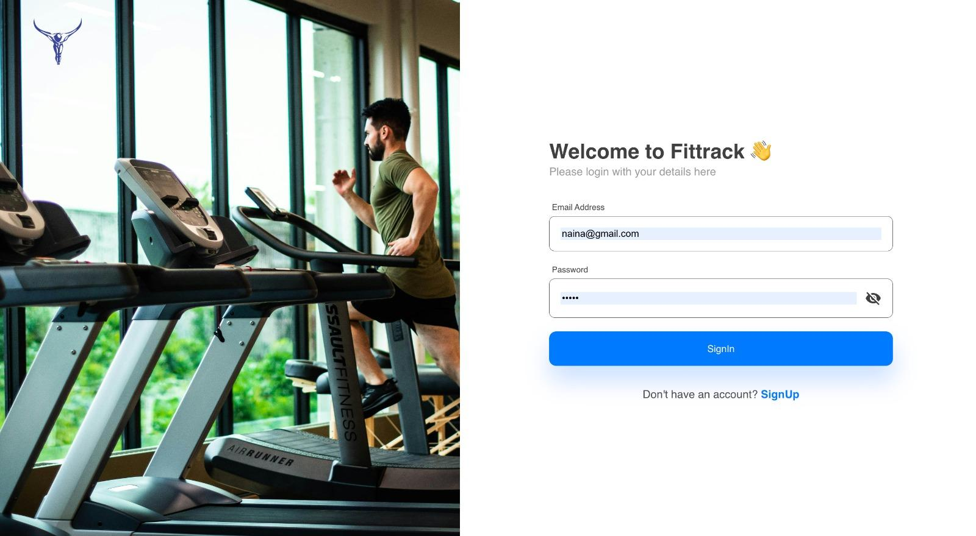
Snapshots

Slide 10
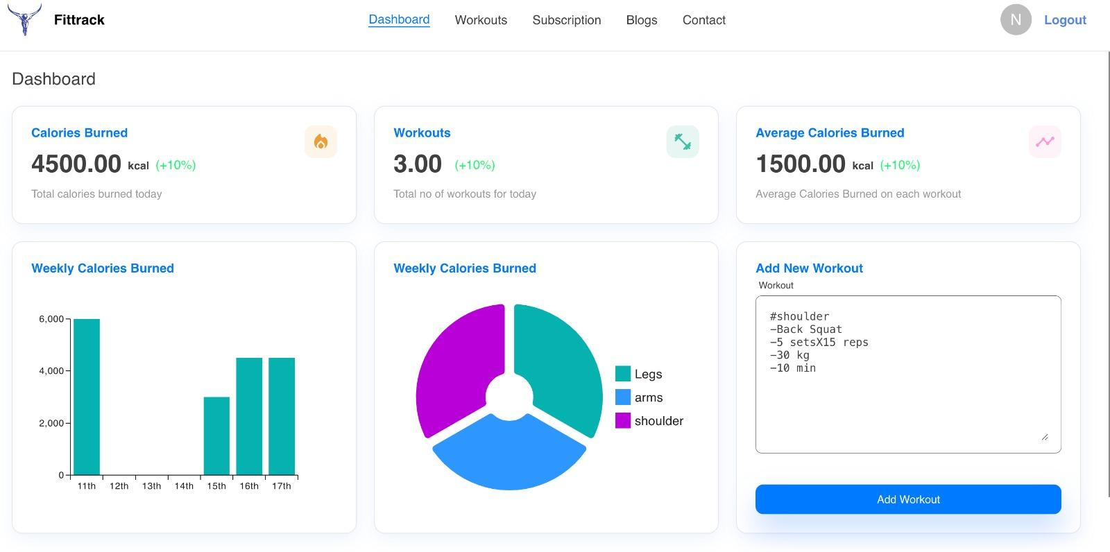

Slide 11
Refrences
Node.js. (n.d.). Introduction to Node.js. Retrieved August 15, 2024, from https://nodejs.org/en/learn/getting-started/introduction-to-nodejs
React. (n.d.). Getting Started. Retrieved August 15, 2024, from https://reactjs.org/docs/getting-started.html
Mongoose. (n.d.). Mongoose v6.1.0: Documentation. Retrieved August 15,2024, from https://mongoosejs.com/docs/
Express. (n.d.). Installing. Retrieved August 15,2024, from https://expressjs.com/en/starter/installing.html
MongoDB. (n.d.). MongoDB Atlas. Retrieved August 15, 2024, from https://www.mongodb.com/cloud/atlas
Mozilla. (n.d.). JavaScript. Retrieved August 15,2024, from https://developer.mozilla.org/en-US/docs/Web/JavaScript
npm. (n.d.). npm. Retrieve August 15, 2024, from https://www.npmjs.com/

Slide 12
Thank You

